Slide 1

Computer Organization and Assembly Language
Dr. Rabia Tabassum

Slide 2

About this Course
Basic Understanding of Computer
Not a difficult course but simplest one
Very difficult to realize that the real computer can be so simple.
Assembly Language programming gives a freehand exposure to the computer and let the programmer talk with it in its language.
To cover the practical aspect of assembly
language programming, IBM PC based on
Intel architecture will be used as an example.

Slide 3

Course Requirements
Basic digital logic operations of AND, OR, and NOT etc.
Binary Numbers and their arithmetic.
Hex Number and their arithmetic

Slide 4

Course Objectives
You will be able to explain all the basic operations of the computer(CPU).
You could understand the psychology of the computer.
You will understand the limitations and capabilities of computer.
How to write programs by understanding the hardware structure.
Your logic will become fine grained.

Slide 5
Computer Organization
Computer organization is concerned with the way hardware components operate and the way they are connected together to form a computer system.
OR
Computer organization is concerned with the structure and behavior of a computer system.

Slide 6
Assembly Language Programming
An assembly language is a low-level programming language designed for a specific type of processor
Assembly language is used to write programs using alphanumeric symbols (or mnemonic), e.g. ADD, MOV, PUSH etc.
Assembly Language depends on the machine code instructions – Every assembler has its own assembly language
Assembly language has a one-to-one relationship with machine language:
– Each assembly language instruction corresponds to a single machine-language instruction.
– A single machine-language instruction can take up one or more bytes of code

Slide 7
Assembly Language Programming
The instruction must specify which operation (opcode) is to be performed and the operands
E.g. ADD AX, BX
– ADD is the operation
– AX is called the destination operand
– BX is called the source operand
– The result is AX = AX + BX
When writing assembly language program, you need to think in the instruction level

Slide 8

Assembly Language Programming
Assembly language programming: Example
MOV AL, 00H
The native language of a computer is machine language (using 0,1 to represent the operation)
The machine language code for the above instruction is
B4 00 (2 bytes)
– After assembled, and linked into an executable program, the value B400 will be stored in the memory
– When the program is executed, then the value B400 is read from memory, decoded and carry out the task
The executable program could be .com, .exe, or .bin files

Slide 9
Assembly Language Programming
Learning assembly language programming will help in understanding the operations of a microprocessor
To learn:
– Need to know the functions of various registers
– Need to know how external memory is organized and how it is addressed to obtain instructions and data (different addressing modes)
– Need to know what operations (or the instruction set) are supported by the CPU

Slide 10
High-level Language
A high-level language (HLL) is a programming language that enables a programmer to write programs that are more or less independent of a particular type of computer
Such languages are considered high-level because they are closer to human languages and further from machine languages.
Examples are C, C++, Java, FORTRAN, or Pascal
High-level languages such as C++ and Java have a one-to-many relationship with assembly language and machine language.
A single statement in C++ expands into multiple assembly language or machine instructions.

Slide 11
High-level Language
The following C++ code carries out two arithmetic operations and assigns the result to a variable. Assume X and Y are integers:
int Y;
int X = (Y + 4) * 3;
Example:
int Y;
int X = (Y + 4) * 3;
Following is the equivalent translation to assembly language.
The translation requires multiple statements because assembly language works at a detailed level:
mov eax,Y ; move Y to the EAX register
add eax,4 ; add 4 to the EAX register
mov ebx,3 ; move 3 to the EBX register
imul ebx ; multiply EAX by EBX
mov X,eax ; move EAX to X

Slide 12
Registers are named storage locations in the CPU that hold intermediate results of operations
Assembler is a utility program that converts source code programs from assembly language into an object file, a machine language translation of the program.
Optionally a Listing file is also produced.
We’ll use MASM as our assembler.
The linker reads the object file and checks to see if the program contains any calls to procedures in a link library.
–The linker copies any required procedures from the link library, combines them with the object file, and produces the executable file.
– Microsoft 16-bit linker is LINK.EXE and 32-bit is Linker LINK32.EXE.
OS Loader: A program that loads executable files into memory, and branches the CPU to the program’s starting address, (may initialize some registers (e.g. IP) ) and the program begins to execute.
Debugger is a utility program, that lets you step through a program while it’s running and examine registers and memory

Slide 13
Listing File
A listing file contains:
– a copy of the program’s source code,
– with line numbers,
– the numeric address of each instruction,
– the machine code bytes of each instruction (in hexadecimal), and
– a symbol table.
The symbol table contains the names of all program identifiers, segments, and related information.

Slide 14
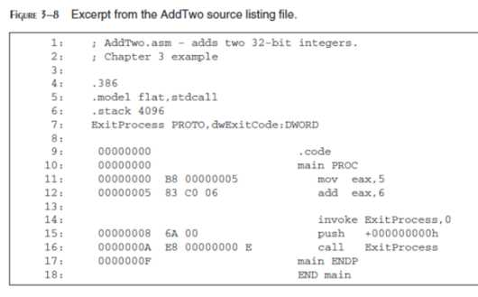

Slide 15
Assembly Language for x86 Processors
Assembly Language for x86 Processors focuses on programming microprocessors compatible with the Intel IA-32 and AMD x86 processors running under Microsoft Windows.
Assembly language bears the closest resemblance to native machine language.
A language whose source programs can be compiled and run on a wide variety of computer systems is said to be portable.
A C++ program, for example, should compile and run on just about any computer, unless it makes specific references to library functions that exist under a single operating system.
A major feature of the Java language is that compiled programs run on nearly any computer system.
Assembly language is not portable because it is designed for a specific processor family.

Slide 16
Assembly Language for x86 Processors
There are a number of different assembly languages widely used
today, each based on a processor family.
Some well-known processor families are
Motorola 68x00, x86, SUN Sparc, Vax, and IBM-370.
The instructions in assembly language may directly match the computer’s architecture or they may be translated during execution by a program inside the processor known as a microcode interpreter.

Slide 17
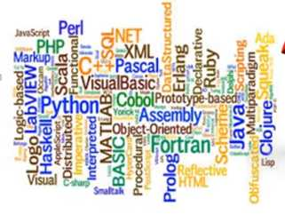

Why should Learn Assembly Language in presence of C++, Javaa, C# , python etc.

Slide 18
Why should Learn Assembly Language in presence of C++, Javaa, C# , python etc.
High level language are near to programmer and far from machine.
We could not directly interact with microprocessor and memory.
Some basic principles of computer architecture, as applied to the Intel IA-32 processor family.
How IA-32 processors manage memory, using real mode, protected mode, and virtual mode.
High level language have certain limitations to access computer hardware.

Slide 19
Why should Learn Assembly Language in presence of C++, Javaa, C# , python etc.
Another use of assembly language is in time critical system called Real Time System
Real Time System have time bound responses with an upper limit of time on certain operations.
In high level language we cannot even tell how many computer instruction were actually used, but in assembly language we can have precise control over them

Slide 20
Why should Learn Assembly Language in presence of C++, Javaa, C# , python etc.
To produce fine grained logic in programmers.
Each and every grain of assembly language has a meaning; nothing is presumed.
Just like a “for” loop in a higher level language is a block construct and has a hundred things hidden in it.
Using the grains of assembly language we do a similar operation with a number of grains but in the process understand the minute logic hidden beside that simple “for” construct.

Slide 21
What you’ll learn from Assembly Language Programming
• How high-level language compilers (such as C++) translate statements from their language into assembly language and native machine code.
How high-level languages implement arithmetic expressions, loops, and logical structures at the machine level.
You will improve your machine-level debugging skills. – Even in C++, when your programs have errors due to pointers or memory allocation, you can dive to the machine level and find out what really went wrong.
High-level languages purposely hide machine-specific details, but sometimes these details are important when tracking down errors.
Assembly language will help you understanding the interaction between the computer hardware, operating system, and application programs.

Slide 22
Virtual Machine Concept
An effective way to explain how a computer’s hardware and software are related is called the virtual machine concept.
A computer can usually execute programs written in its native machine language.
Each instruction in this language is simple enough to be executed using a relatively small number of electronic circuits. For simplicity, we will call this language L0.
Programmers would have a difficult time writing programs in L0 because it is enormously detailed and consists purely of numbers.
If a new language, L1, could be constructed that was easier to use, programs could be written in L1.

Slide 23
Virtual Machine Concept
Rather than using only Language, it is easier to think in term of a hypothetical computer, Virtual Machine , at each level.
Programming Language analogy:
– Each computer has a native machine language (language L0) that runs directly on its hardware
– A more human-friendly language is usually constructed above machine language, called Language L1
Virtual machine acts as a software program that emulates the functions of some other physical or virtual computer.
The virtual machine VM1 , as we will call it , can execute commands written in language L1.
The virtual machine VM0 can execute commands written in language L0.

Slide 24
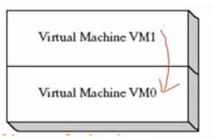
Virtual Machine Concept
Program written in VM1 can Interpreted / Translated
and Executed on machine VM0

Slide 25
Virtual Machine Concept
Programs written in L1 can run in two different ways:
Interpretation:
L0 program interprets and executes L1 instructions one by one.
Translation:
L1 program is completely translated into an L0 program (which then runs on the computer hardware)

Slide 26
Virtual Machine Concept
What if the language VM1 supports is still not programmer friendly enough to be used for useful application?
Then another virtual machine, VM2, can be designed that is more easily understood.
This process can be repeated until a virtual machine VMn.
VMn can be designed to support a powerful , easy-to-use language.

Slide 27
Virtual Machine Concept
English: Display the sum of A times B plus C.
C++:
cout << (A * B + C);
Assembly Language:
mov eax,A
mul B
add eax,C
call Write Int
Intel Machine Language:
A1 00000000
F7 25 00000004
03 05 00000008
E8 00500000

Slide 28
JAVA – JVM
The Java programming language is based on the virtual machine concept.
• A program written in the Java language is translated by a Java compiler into Java byte code - a low-level language
• Java byte code is executed at runtime by a program known as a Java virtual machine (JVM).
The JVM has been implemented on many different computer system, making java programs relatively System Independent.
JVM is platform dependent that means there are different implementation of JVM on different OS.

Slide 29
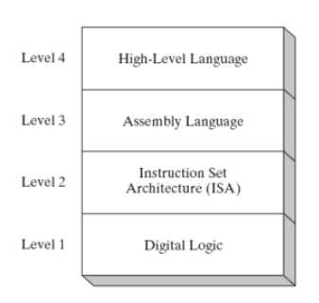
Virtual Machine Levels

Slide 30
Virtual Machine Levels
Level 4 High Level languages
• Application-oriented languages – C++, Java, Pascal, Visual Basic . . .
• Programs compile into assembly language (Level 3)
Level 3 Assembly Language
• Instruction mnemonics that have a one-to-one correspondence to machine language
• Programs are translated into Instruction Set Architecture Level - machine language (Level 2)
• The instructions in assembly language may directly match the computer’s architecture or they may be translated during execution by a program inside the processor known
as a microcode interpreter.
Level 2 Instruction Set Architecture (ISA)
• Also known as conventional machine language
• Executed by Level 1 (Digital Logic)
Level 1 Digital Logic
• CPU, constructed from digital logic gates
• System bus • Memory
• Implemented using bipolar transistors

Slide 31
Data Representation
Binary Integers :
- Translating between binary and decimal
Binary Addition
Integer Storage Sizes
Hexadecimal Integers
- Translating between decimal and hexadecimal
Hexadecimal Addition
Hexadecimal subtraction
Signed Binary Integers
Binary subtraction
Character Storage

Slide 32
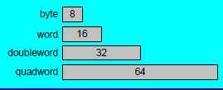
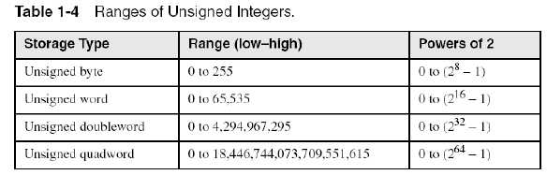
Integer Storage Sizes
Standard sizes:

Slide 33
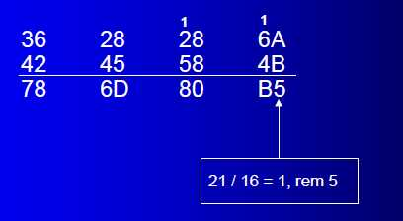
Hexadecimal Addition
Divide the sum of two digits by the number base (16). The quotient becomes the carry value, and the remainder is the sum digit.
Important skill: Programmers frequently add and subtract the addresses of variables and instructions.

Slide 34
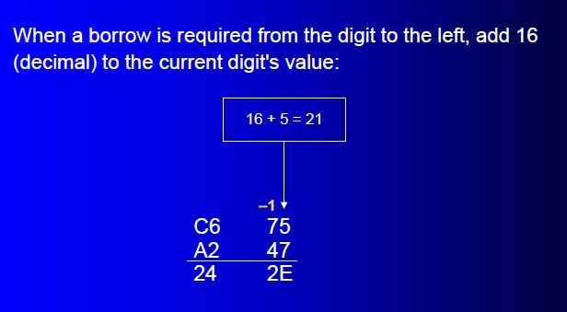
Hexadecimal Subraction
Example:
The address of var1 is 00400020. The address of the next variable after var1 is 0040006A. How many bytes are used by var1?

Slide 35
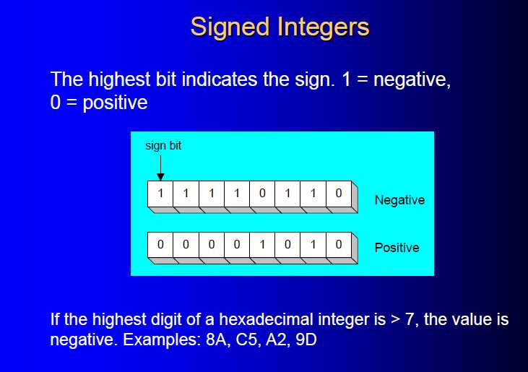

Slide 36


Slide 37
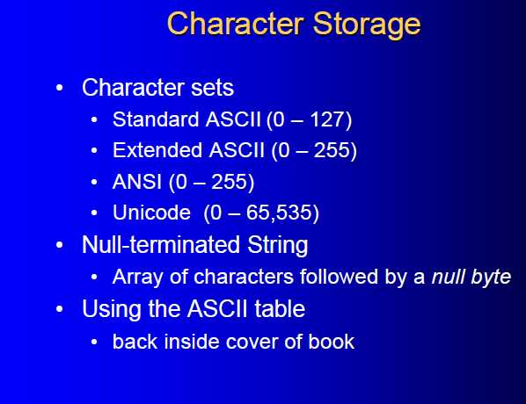

Slide 38
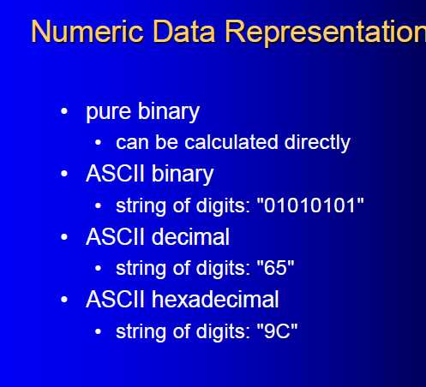

Slide 39
